Slide 1
UCIe™
(Universal Chiplet Interconnect Express™)
Building an open ecosystem of chiplets
for on-package innovations
Presented by
UCIe Promoters

Slide 2
Moore Predicted
“Day of Reckoning”
“It may prove to be more economical to build large systems out of smaller functions, which are separately packaged and interconnected.”*
- Gordon E. Moore
*“Cramming more components onto integrated circuits,” Electronics, Volume 38, Number 8, April 19, 1965
2

Slide 3
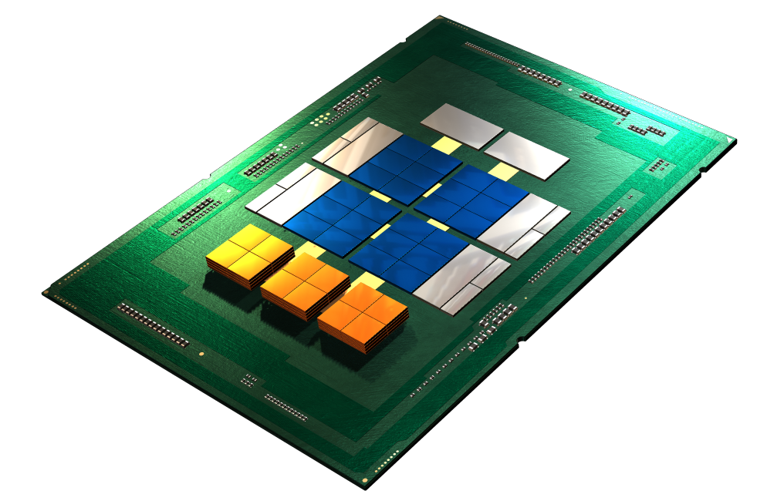
Motivation
OPEN CHIPLET: PLATFORM ON A PACKAGE
Align Industry around an open platform to enable chiplet based solutions
High-Speed Standardized
Chip-to-Chip Interface (UCIe)
20X I/O Performance at 1/20th Power vs off-package SerDes at Launch
Gap more prominent with better on-package technologies in future
Customer IP &
Customized Chiplets
Enables construction of SoCs that exceed maximum reticle size
Package becomes new System-on-a-Chip (SoC) with same dies (Scale Up)
Reduces time-to-solution (e.g., enables die reuse)
Lowers portfolio cost (product & project)
Enables optimal process technologies
Smaller (better yield)
Reduces IP porting costs
Lowers product SKU cost
Enables a customizable, standard-based product for specific use cases (bespoke solutions)
Scales innovation (manufacturing and process locked IPs)
Sea of Cores
(heterogeneous)
Memory
Advanced 2D/2.5D/3D Packaging
Heterogeneous Integration Fueled by an Open Chiplet Ecosystem
(Mix-and-match chiplets from different process nodes / fabs / companies / assembly)
3

Slide 4
Key Metrics and Adoption Criteria
UCIe - Architected and specified from the ground-up to deliver the best KPIs while meeting wide adoption criteria
Key Performance Indicators
Bandwidth density (linear & area)
Data Rate & Bump Pitch
Energy Efficiency (pJ/b)
Scalable energy consumption
Low idle power (entry/exit time)
Latency (end-to-end: Tx+Rx)
Channel Reach
Technology, frequency, & BER
Reliability & Availability
Cost
Standard vs advanced packaging
Factors Affecting Wide Adoption
Interoperability
Full-stack, plug-and-play with existing s/w is+
Different usages/segments
Technology
Across process nodes & packaging options
Power delivery & cooling
Repair strategy (failure/yield improvement)
Debug – controllability & observability
Broad industry support / Open ecosystem
Learnings from other standards efforts
4

Slide 5
Jumpstarting UCIe
Intel donates initial specification
STANDARD SPECIFICATIONS
Physical Layers
Initial D2D I/O
Protocols
CXL™/PCIe®
Form Factors
Management
Focus of UCIe 1.0 Specification
Physical Layer: Die-to-Die I/O with industry-leading KPIs
Protocol: CXL™/PCIe® for near term volume attach
SoC construction issues are addressed since CXL/PCIe is a board-to-board interface
CXL/PCIe addresses common use cases
I/O attach with PCIe/CXL.io
Memory use cases: CXL.mem
Accelerator use cases: CXL.cache
Well defined specification: ensure interoperability and future evolution
Future: the chiplet journey is just starting!!
Other protocols
Advanced Chiplet form-factors (e.g., 3D)
Chiplet management
More to come ….
PROTOCOL LAYER
FIT AWARE / D2D INTERFACE (FDI)
DIE-TO-DIE ADAPTER
ARB/MUX (when applicable)
CRC/RETRY (when applicable)
LINK STATE MANAGEMENT
PARAMETER NEGOTIATION
RAW D2D INTERFACE (RDI)
PHYSICAL LAYER
LINK TRAINING
LANE REPAIR (when applicable)
LANE REVERSAL (when applicable)
SCRAMBLING/DE-SCRAMBLING (opt-in)
SIDEBAND TRAINING & TRANSFERS
ANALOG FRONT END
CLOCK FORWARD
Die
-
1
Die
-
0
Die
-
2
Package Substrate
(Standard Package)
Die
-
1
Die
-
0
Die
-
Die
2
-
1
Die
-
Die
2
-
0
Interposer (e.g. CoWoS)
Silicon Bridge
Package Substrate
Silicon Bridge
(e.g. EMIB)
(e.g. EMIB)
Package Substrate
(Multiple Advanced Package Choices)
(Different flavors of packaging options supported to build an open ecosystem)
5

Slide 6
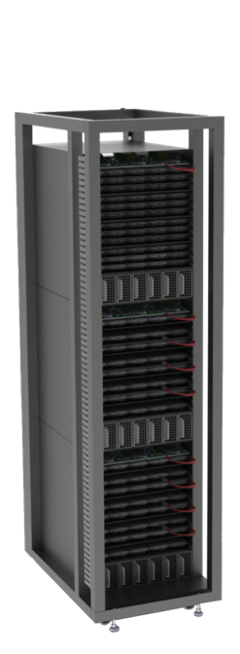
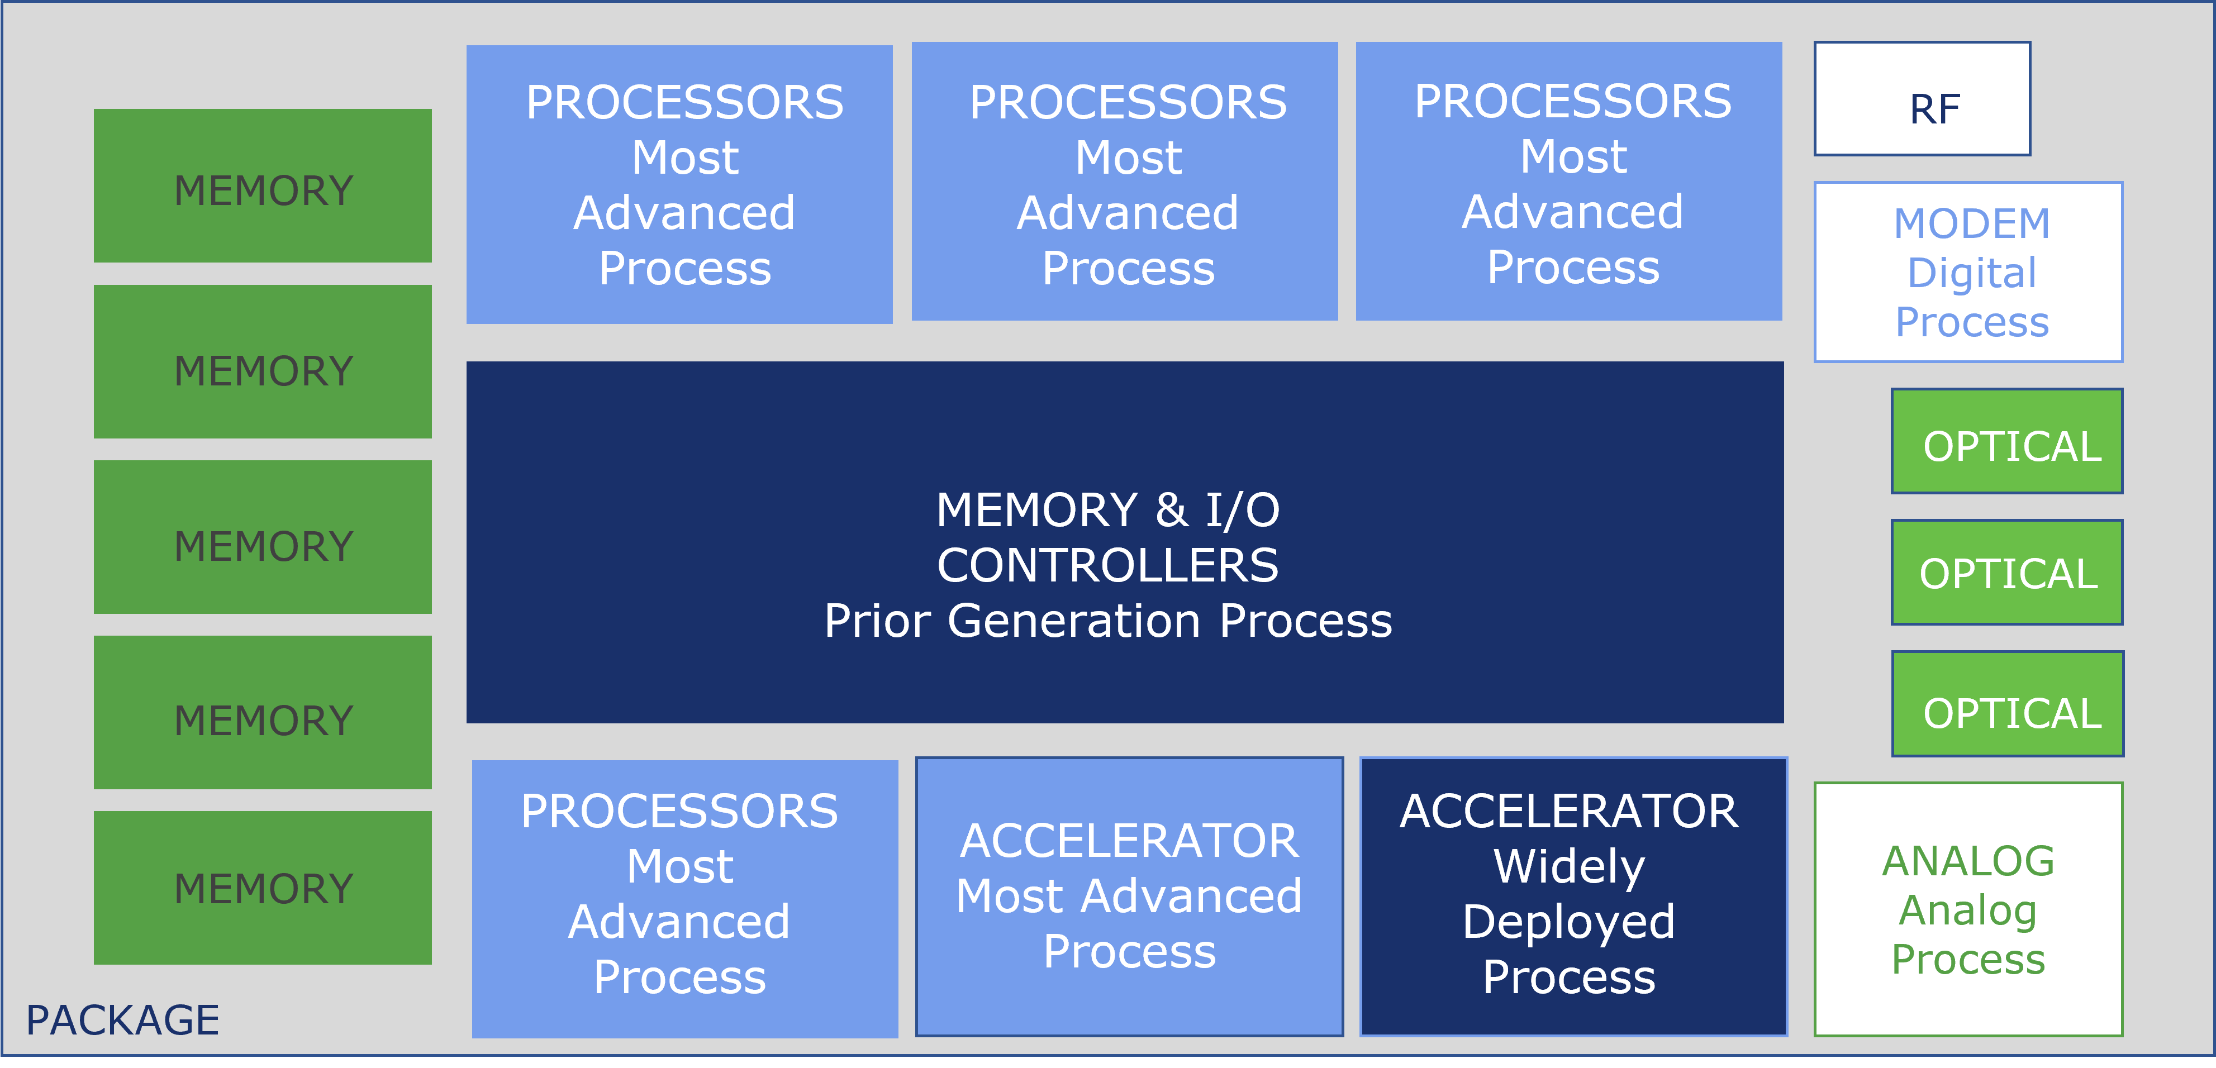
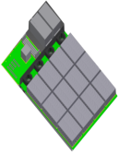
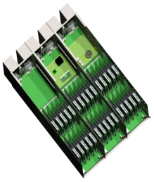
Usage Models Supported by UCIe
TORS
CXL Pooled Memory/
Storage
X
Compute
(Memory/ Storage Drawer)
(w/ UCIe-based SoCs)
X
CPU
• • •
CPU
Compute
X
SSD
• • •
SSD
Compute
X
HDD
• • •
HDD
(Compute Drawer)
(w/ UCIe-based SoCs)
SoC Package level construction for wide range of usages from Hand-held to high-end servers
Mix and match dies from multiple sources with different packaging options
UCIe / CXL through UCIe Retimer
Provision to extend off-package with UCIe Retimers connecting to other media (e.g., optics, electrical cable, mmWave)

Slide 7
UCIe 1.0 delivers the best KPIs while meeting the projected needs for the next 5-6 years.
Wide industry leader adoption spanning semiconductor, manufacturing, assembly, & cloud segments.
UCIe 1.0: Characteristics and Key Metrics
CHARACTERISTICS | STANDARD PACKAGE | ADVANCED PACKAGE | COMMENTS
Data Rate (GT/s) | 4, 8, 12, 16, 24, 32 |  | Lower speeds must be supported -interop (e.g., 4, 8, 12 for 12G device)
Width (each cluster) | 16 | 64 | Width degradation in Standard, spare lanes in Advanced
Bump Pitch (um) | 100 – 130 | 25 - 55 | Interoperate across bump pitches in each package type across nodes
Channel Reach (mm) | <= 25 | <=2
Characteristics / KPIs
Standard Package
Data / Outcome
Data / Outcome
Your Key Performance Indicator goes here
Add a few details describing the related activities
What results did you obtain from your project?
Write them here.
Your Key Performance Indicator goes here
Add a few details describing the related activities
What results did you obtain from your project?
Write them here.
KPIs / TARGET FOR KEY METRICS | STANDARD PACKAGE | ADVANCED PACKAGE | COMMENTS
B/W Shoreline (GB/s/mm) | 28 – 224 | 165 – 1317 | Conservatively estimated: AP: 45u; Standard: 110u; Proportionate to data rate (4G – 32G)
B/W Density (GB/s/mm²) | 22-125 | 188-1350
Power Efficiency target (pJ/b) | 0.5 | 0.25
Low-power entry/exit latency | 0.5ns <=16G, 0.5-1ns >=24G |  | Power savings estimated at >= 85%
Latency (Tx + Rx) | < 2ns |  | Includes D2D Adapter and PHY (FDI to bump and back)
Reliability (FIT) | 0 < FIT (Failure In Time) << 1 |  | FIT: #failures in a billion hours (expecting ~1E-10) w/ UCIe Flit Mode
Your Key Performance Indicator goes here
Add a few details describing the related activities
What results did you obtain from your project?
Write them here.
7

Slide 8
Board Members
Leaders in semiconductors, packaging, IP suppliers, foundries, and cloud service providers are joining together to drive
The open chiplet ecosystem.
JOIN US!
8

Slide 9
Summary
Leaders in semiconductors, packaging, IP suppliers, foundries, cloud service providers join forces to launch Universal Chiplet Interconnect Express (UCIe) technology to standardize the chiplet ecosystem today and future generations of chiplet technology.
New open standard establishes an open chiplet ecosystem and ubiquitous interconnect at the package level.
UCIe 1.0 Specification ratified to provide a complete standardized die-to-die interconnect with physical layer, protocol stack, software model, and compliance testing that will enable end users to easily mix and match chiplet components from a multi-vendor ecosystem for System-on-Chip (SoC) construction, including customized SoC.
The specification is available to the public https://www.uciexpress.org/specification
UCIe Consortium is officially incorporated and welcomes interested companies and institutions to join the organization at the Contributor and Adopter level.
Established 5 Technical Working Groups (Electrical, Protocol, Form Factor/Compliance, Manageability / Security, Systems and Software) and Marketing Working Group
Learn more by visiting www.UCIexpress.org
9

Slide 10
Thank You
www.UCIexpress.org

